Slide 1



2020 Census: The Role of Schools
Pauline Núñez, Partnership Coordinator
U.S. Census Bureau – Denver Region
North Texas Regional P-16 Council
Thursday, April 5, 2018
Texas Women’s University, Dallas, TX
Notes:
Good morning/afternoon, my name is (insert NAME), from the Census Bureau’s (insert Division or Regional Office). Thank you for the opportunity to speak with you today to give you some general information on the 2020 Census and the important geographic programs that create the foundation for a successful Census..

Slide 2
Agenda
Welcome and Introductions
2020 Census-Overview
Operational Timeline
Community Partnership and Engagement Program
Critical Next Steps and Q&A
Notes:
Though I intend to focus a lot and the geographic programs and especially the Local Update of Census Addresses (LUCA), I am going to begin by providing some high level information regarding the Decennial Census, the design for the 2020 Census and the maintenance of the census address list and just a little about local community engagement as we approach and conduct the 2020 Census.
For LUCA specifically I will cover the background, confidentiality and security, new aspects of 2020 LUCA, who can participate as well as numerous preparation topics including early tools, participation methods, product formats for the address list and maps, the next steps for participants and the 2020 LUCA schedule.

Slide 3
Why We Do a Census?
Article 1, Section 2 of the US Constitution
  The actual enumeration shall be made within three years after the first meeting of the Congress of the United States, and within every subsequent term of ten years, in such manner as they shall by law direct.
Notes:
Ask the audience, “Why do we do the Census?”
Bottom line it is mandated by the Constitution, so it is required.
Does anyone know what year we did the first Census? (1790).
Anyone know what day Census day is? (April 1). The Census is a snapshot of where all individuals who reside in the US live on that specific day.

Slide 4

The Decennial Census
Conduct a census of population and housing Disseminate results to the President, the states and the American People
Uses of Census data:
  Apportion representation among states
  Draw congressional and state legislative districts, school districts and voting precincts
  Enforce voting rights and civil rights legislation
  Distribute federal dollars to states
  Inform planning decisions of federal, tribal, state and local government
  Inform organizational decisions (e.g., where to locate, size of market, etc.) of businesses and non-profits
Notes:
2,054,746,
Counting for Dollars 2020
16 Large Federal Assistance Programs that Distribute Funds on Basis of Decennial Census-derived Statistics (Fiscal Year 2015)
Montana
Total Program Obligations: $$43,334,650,874, $1578 per capita
Per Capita: $1,989 (see note on proper use) CFDA #
Counting for Dollars 2020: The Role of the Decennial Census in the Geographic Distribution of Federal Funds ,
Additional data uses include:
To draw congressional and state legislative districts, school districts and voting precincts by states, tribes, and local governments
To enforce voting rights and civil rights legislation by the Department of Justice
To distribute more than 400 billion dollars EACH YEAR in federal funding for than 1,000 programs administered by 26 federal agencies to tribal, state, and local governments. Census population figures form the basis for the allocation of significant amounts of federal funding. Missing a housing unit, and the associated population, during the decennial census may result in a missed opportunity for governments to benefit, which perpetuates until the next decennial census.
To inform the decisions of governments, businesses and non-profits regarding community and regional development, education, agriculture, energy, and environmental programs, as well as other community improvements and enhancements. Census data informs communities so they may allocate their own funding for neighborhood improvements, public health, education, transportation and much more.

Slide 5
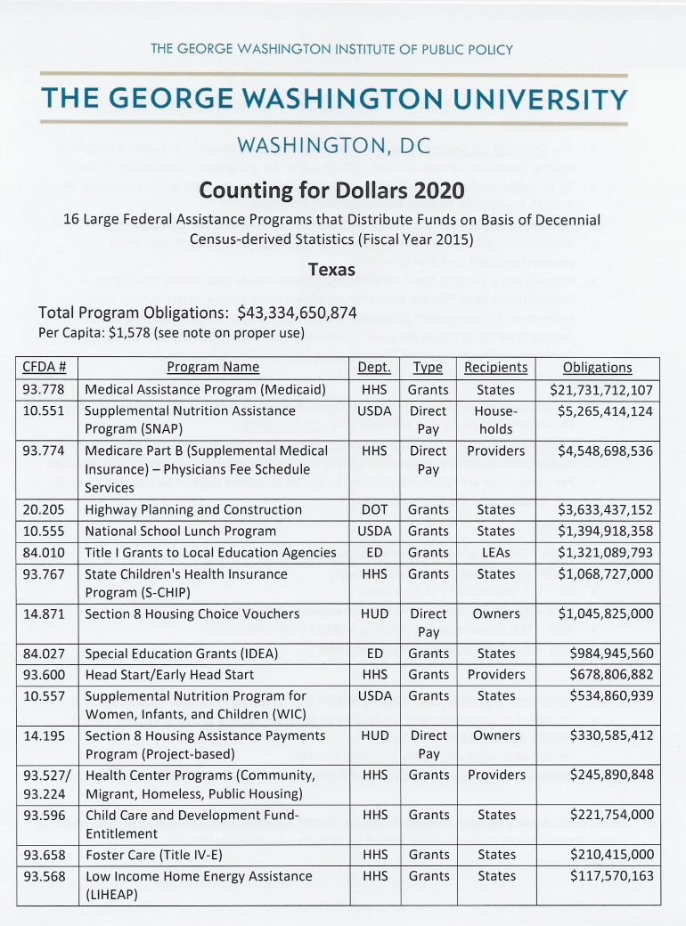
Federal Funding for Texas
Texas receives over $43 billion dollars per year based on Decennial Census data.
The per capita allocation is $1,578.

Slide 6
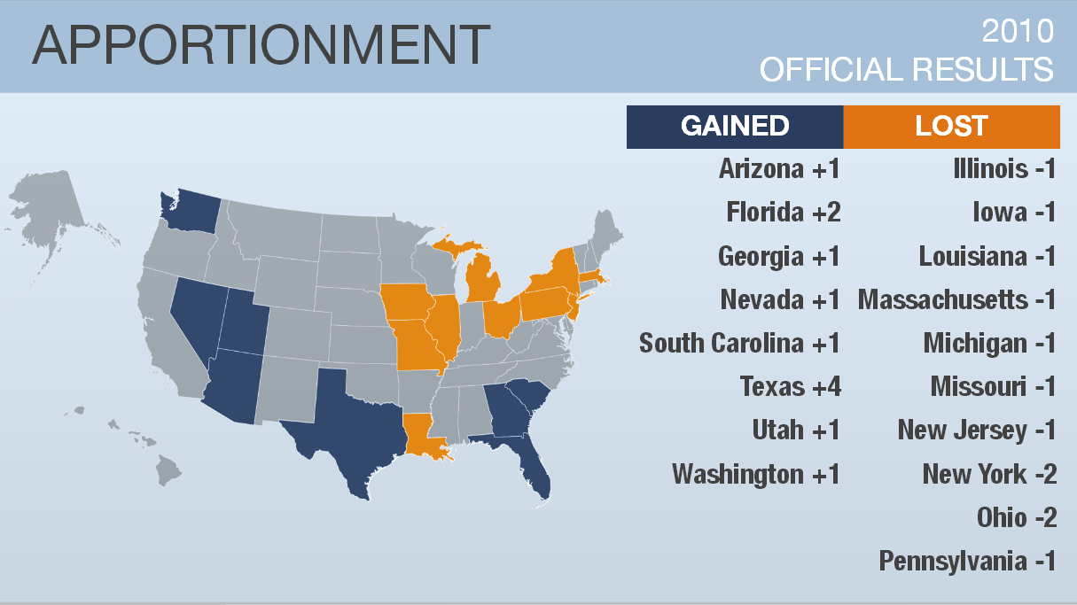
TX is projected to gain 3-4 seat!
Notes:
This map shows what changed as far as seats in Congress after the last Census – who gained and lost.
The Census Bureau never does projections but other agencies do. Election Data Services published the following in Dec 2016
Gaining States Losing States
Arizona – 1 or 2 seats Alabama – 1 seat
Colorado – 1 seat Illinois – 1 or 2 seats
Florida – 2 seats Michigan – 1 seat
Montana – 1 seat Minnesota – 1 seat
North Carolina – 1 seat New York – 1 seat
Oregon – 1 seat Ohio – 1 seat
Texas – 3 or 4 seats Pennsylvania – 1 seat
Rhode Island – 1 seat
West Virginia – 1 seat

Slide 7
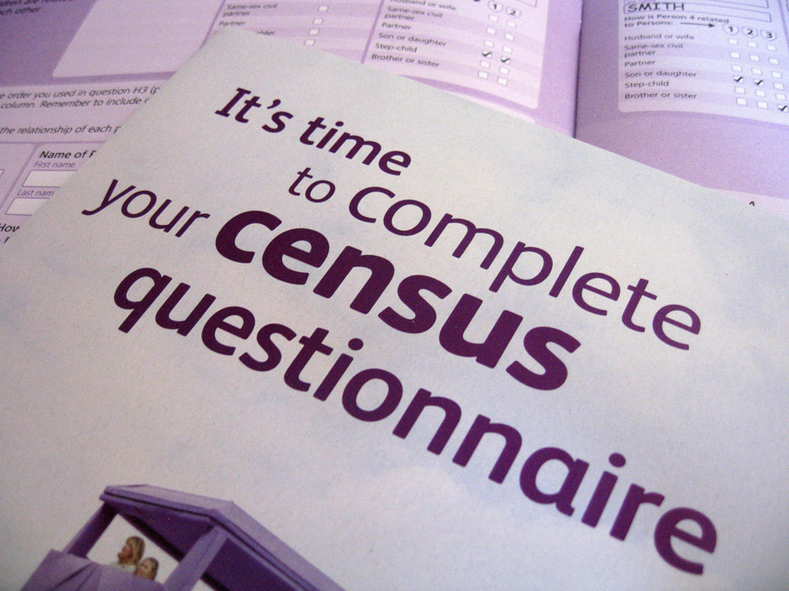
New Ability to Self Respond
Starting March 23, 2020
Internet
Phone
Paper Form
Or traditional in-person interview
Notes:
Let’s move onto our second innovation area is OPTIMIZING SELF-RESPONSE.
In other words, how do we engage and motivate the public to respond?
The goal of optimizing self-response is to: generate the largest possible self-response, thereby reducing the number of households requiring follow-up.
In the 2020 Census we will be including the internet as a response option as well as the ability for someone to call our toll free number and give and interview over the phone. Both the internet and phone will be available in a number of different languages other than English and Spanish. Those that do not respond via the internet or live in an area with poor internet response will also be given the option to respond on paper. Everyone who does not self respond, we will visit in person and collect the information.

Slide 8
Census Mobilization Process
Education
Promotion
Motivation/Action
Education Phase January Engage & Educate Local Leaders, Partners & Communities January 2018-September 2019
Promotion Phase Promote Participation April 2019-January 2020
Motivation /Action Phase Call to Action for Residents to Respond February 2020-June2020

Slide 9
Key Data Collection Dates
Nov – 2019
April 2018
January-Feb 2019
Aug – Oct 2019
Jan-Aug-2019
Early 2020
March 23, 2020
April 1, 2020
May 2020
August 2020
December 31, 2020
In-Office Address Canvass
Regional Census Center Opens
Early Area Census Offices Open
Address Canvassing – select areas
Area Census Offices Open
Group Quarters Start
Self Response Starts
CENSUS DAY
Non-Response Follow-Up Starts
Data Collection Complete
Counts Delivered to President
Notes:
Now -2019 – In office address canvassing is happening in our Jeffersonville, In processing center. Using the latest technologies, images and local sources, the staff is determining the areas which are stable and do not need boots on the ground and those areas where growth or revitalization of neighborhoods is occurring and where we will canvass with census listers. We anticipate we will need to field visit between 25-30% of all blocks in the US. This limited work in the field will be a cost savings over previous censuses where we canvassed every road in the country.
Jan 2018 – We will open the Regional Census Center in Dallas, TX which will conduct the census operations in our 12 State region.
Spring-Summer 2019 – we will open 6 early census offices who will recruit for and conduct the Field Canvassing operations in the Aug-Oct 2019 time frame
Fall 2019 – The other 44 offices in our 12 State region will open
Early 2020 – we will begin the process of identifying and locating all the group quarters in the region. Group Quarters are special living situations such as college dormitories, prisons, nursing and assisted living homes, and shelters to mention a few. The early GQ operations will determine points of contact and basic information. This is an important operation and we will probably ask cities and counties to help identify and locate these special situations.
March 23, 2020 – the census is finally here and this is the first opportunity to self respond via the internet and fill out your census form!
April 1, 2020 is Census Day
May 2020 – For all of those households that have not responded, we will be out in force, knocking on doors and trying to get the non-responders interviewed and their forms officially counted. Enumerators will have hand-held devices to conduct the data collection. If you don’t want someone knocking on your door, self respond via the internet or by phone/paper before mid May!
August 2020 – the Census is over, the Census is over
December 31, 2020 – counts delivered to the President

Slide 10



COMMUNITY PARTNERSHIP
AND
ENGAGEMENT PROGRAM
Notes:
During the 2010 Census, over 250,000 partners pulled together to spread the message about the importance of participation in their communities. These trusted voices served as Census ambassadors helping America equal the participation rate from 2000, saving millions of taxpayer dollars. Our quarter million partners ran the spectrum of government, non-profit, corporate and community organizations that spread the message and mobilized their constituents to support the goal of a complete count.

Slide 11
Community Partnership and Engagement Program
Enroll community partners to increase participation in the 2020 Census of those who are less likely to respond or are often missed.
Educate people about the 2020 Census
Encourage community partners to motivate people to self-respond
Engage grass roots organizations to reach out to hard to count groups and those who are not motivated to respond to the national campaign
Notes:
The Community Partnership and Engagement Program or CPEP creates the community or grassroots level partnerships throughout the US.
This program focuses on
Motivating diverse communities toward greater participation in the Census
Mobilize community leaders to exponentially engage their constituents to be counted
Outreach to populations with historically low response rates and hardest to count
The CPEP objective is to Enroll community partners to increase decennial participation of those who are less likely to respond or are often missed by using the 3 “E’s”
Educate people about the 2020 Census and foster cooperation with enumerators
Encourage community partners to motivate people to self-respond
Engage grass roots organizations to reach out to hard to count groups and those who aren’t motivated to respond to the national campaign

Slide 12
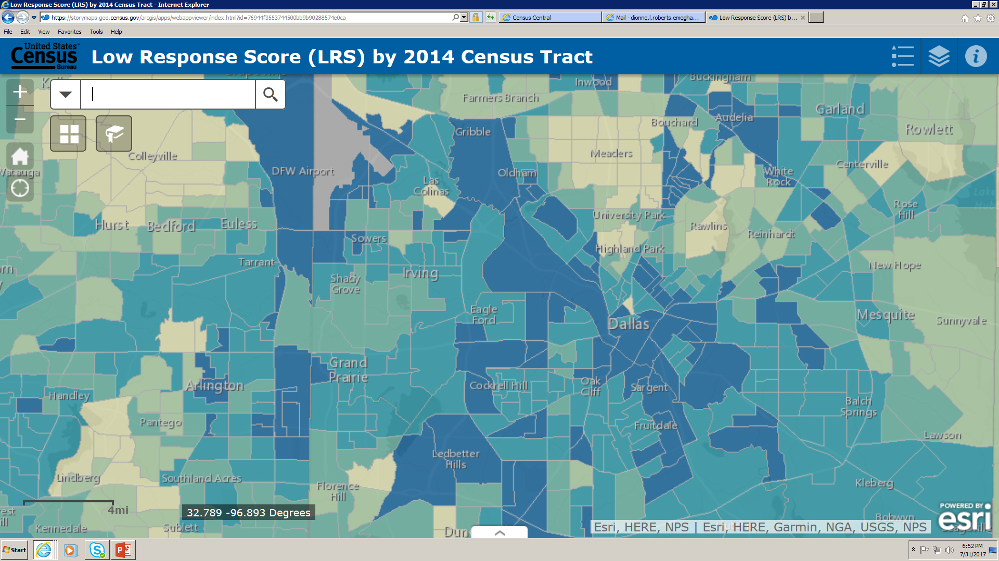
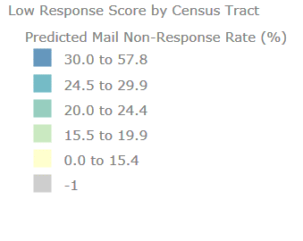
Response Outreach Area Mapper (ROAM)
City of Dallas
https://www.census.gov/roam
Notes:
The Planning Database includes the Low Response Score, 2010 Census operational data, and select American Community Survey (ACS) estimates. In its raw form, the Planning Database can be used in many ways, including the following:
Identifying areas where special outreach and promotion efforts could be considered.
Linking spatial map data files to create thematic maps.
Generating reports, cross tabulations, and simple analyses.
Planning recruitment activities.
This application was developed to make the hard-to-survey areas easier to identify and to provide a socioeconomic and demographic characteristic profile of these areas using ACS estimates available in the Planning Database. Hard-to-survey areas—those identified by high Low Response Scores—across the country are hard-to-survey for different reasons. Learning about each hard-to-survey area allows the U.S. Census Bureau to create a tailored communication and partnership campaign, and to plan for field resources including hiring staff with language skills. These and other efforts can improve response rates.

Slide 13
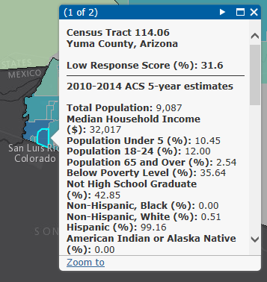
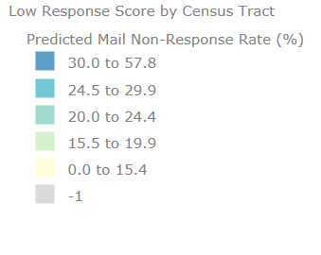
Low Response Score by Census Tract

Slide 14



STATISTICS IN SCHOOLS
https://www.census.gov/schools/

Slide 15
Schools Checklist
Take a leadership position on the 2020 Census-help your community understand the importance and how their communities’ future is impacted
Take an active role in your Local Complete Count Program and make sure your schools/ community’s challenges are represented
Support Census Recruiting Efforts for jobs
Help us Identify Trusted Voices key leaders in education, health, philanthropy, corporations, faith based organizations and community based organizations
Help Educate communities on self-response to include children
Help us Identify Early Childhood Development Networks

Slide 16

Schools will COUNT in the 2020 Census!
For future reference contact Pauilne Nunez @ Pauline.Nunez@census.gov

